Slide 1
Create a simple Streamlit app
Vương Tuấn Anh
AI Engineer
anh.vt@citigo.com.vn

Slide 2
Table of Contents
01
02
03
Display text on Streamlit
Add widgets to Streamlit
Create web-app demo
https://medium.com/international-school-of-ai-data-science/make-your-streamlit-web-app-look-better-14355c2db871
https://medium.com/@stefsmeets/streamlit-pyside-standalone-data-app-815567828f4e

Slide 3
01
Display text on Streamlit

Slide 4
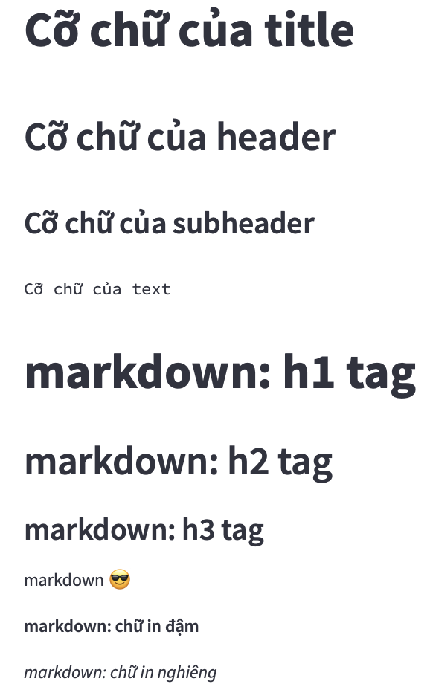
st.title(...)
st.header(...)
st.subheader(...)
st.text(...)
st.markdown(...)

Slide 5
02
Add widgets to Streamlit

Slide 6
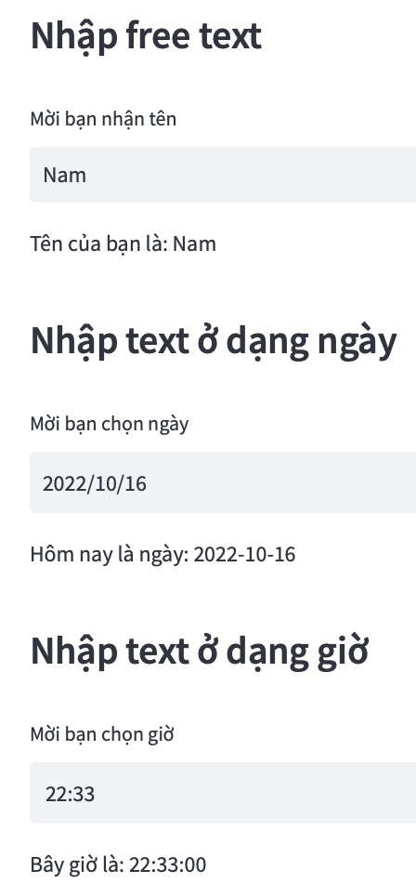
st.text_input(...)
st.date_input(...)
st.time_input(...)

Slide 7
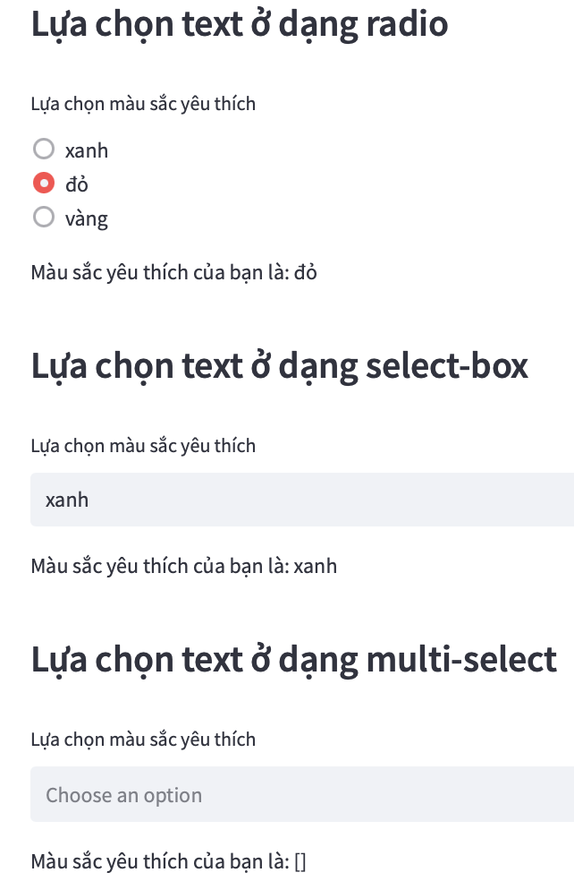
st.radio(...)
st.selectbox(...)
st.multiselect(...)

Slide 8
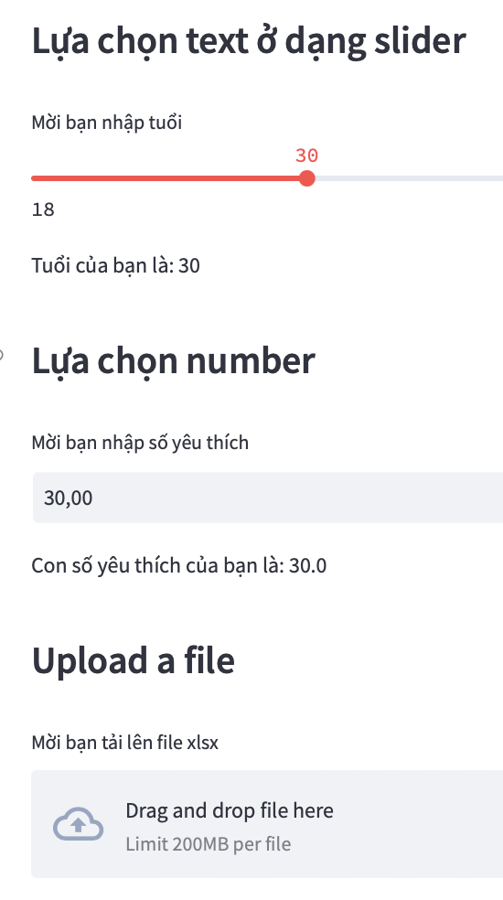
st.slider(...)
st.number_input(...)
st.file_uploader(...)

Slide 9
03
Create web-app demo

Slide 10
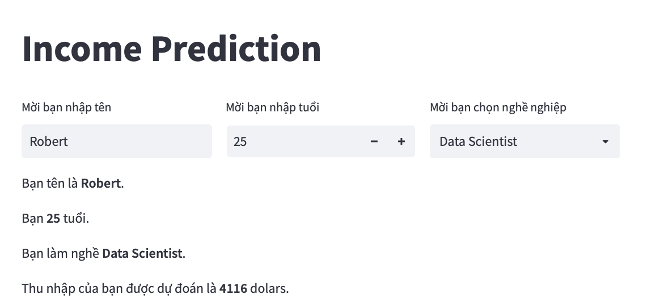
Our web-app

Slide 11
Reference
https://streamlit.io
Streamlit tutorial on youtube
https://slidesgo.com

Slide 12
Thanks!
Do you have any questions?

